Slide 1
Copyright Laws
What teachers need to know.

Slide 2
What is copyright?
Copyright refers to the original author’s exclusive right to reproduce, distribute copies and publicly display their work.
Copyright is limited by duration and under U.S. law, by fair use.
Notes:
Copyright provides legal protection for original creative works, including poetry, movies, video games, videos, plays, paintings, sheet music, recorded music performances, novels, software code, sculptures, photographs, choreography and architectural design.

Slide 3
What is “Fair Use”?
An exception to the exclusive protection of U.S. copyright law.
It permits certain limited uses without permission from the author or owner.
Notes:
Depending of the circumstances, copying may be considered “fair use” for purposes such news reporting, teaching, scholarship or research. There are four factors the courts require to determine whether a specific use is “fair use”. Education purposes do not guarantee permission to copy or distribute work.

Slide 4
“Fair Use” Factors
Purpose and character of the use.
Nature of the copyrighted work.
Amount of the work used.
Effect of any use on the market for the work.
Notes:
This is for nonprofit educational purposes. Teacher and students are protected within certain guidelines.
Is the work factual, creative or published?
It the copied amount long or short in length? Are you copying the entire work?
It is not fair use to copy for a commercial motive or for the soul purpose of not purchasing the needed material.

Slide 5
Printed Material
Short
Archives
Teachers may make multiple copies for classroom use, and incorporate into multimedia for teaching classes.
Students may incorporate text into multimedia projects.
A librarian may make up to three copies “solely for the purpose of replacing a copy that is damaged, deteriorating, lost, or stolen.”
Notes:
Short - Copies may be only from legally acquired originals. One copy allowed per student. Teachers may make copies in nine instances per class per term. “Consumables,” such as workbooks, may not be copied.
Archives – Copies must contain copyright information. Archiving rights are designed to allow libraries to share with other libraries one-of-a-kind and out-of-print books.

Slide 6
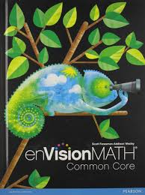
Scenarios
Your district purchased math workbooks (consumables) for every 4th grade student and you receive just enough for you class at the beginning of the year. One month into the school year, you have a new student. Do you just make a copy of the math workbook for the new student?
Notes:
No, because consumables may not be copied. You will have to request another copy of the math workbook from your administration.

Slide 7
Videos
For viewing-
For multimedia/projects
Teachers may use these materials in the classroom.
Copies may be made for archival purposes or to replace lost, damaged, or stolen copies.
Students may use 10% or 3 minutes of lawfully acquired copyright works in their academic multimedia.
Notes:
Viewing - The material must be legally acquired. Material must be used in a classroom for instruction. Copying is permitted only if replacements are unavailable at a fair price or in a viable format.

Slide 8
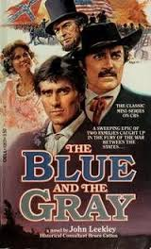
Scenario
A teacher rents a DVD of the film The Blue and The Gray from a local video store to show in her class on Civil War. The disc is labeled For Home Use Only. Is this use permitted?
Notes:
This use falls within the 110(1) exemption of the U.S. Copyright Law that permits a classroom viewing in the context of a class session. Public performances of the video to a campus club would not be covered. Showing the same DVD to the class by “streaming” it through a Blackboard site is not covered by this exemption and certain criteria would need to be met to deliver the material in that fashion.

Slide 9
Internet
Images may be downloaded for student projects and teacher lessons.
Sound files and video may be downloaded for use in multimedia projects.
Notes:
Resources from the Web may not be reposted onto the Internet without permission. However, links to legitimate resources can be posted. Any resources you download must have been legally acquired by the Website.

Slide 10
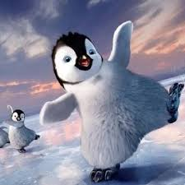
Scenario
A professor has assigned his students to use images of photographs or art works from DC museums to create a poster about a book they have read for the course. Students can use multiple images or use image software to manipulate the images. Is this use permissible?
Notes:
Although the students would be creating derivative works, this application may fall within fair use assuming that no further use will be made of the material beyond the classroom (e.g., the material is not going to be posted to a public Web site or displayed at an exhibit). To acknowledge the moral rights of the artist, it would be appropriate for the students to document in writing the nature of the changes they made to the original works and to cite the ownership and description of those works.

Slide 11
References
American University Library (2010). What Faculty Need to Know About Copyright for Teaching. Retrieved on March 6, 2016 from https://www.american.edu/library/documents/upload/Copyright_for_Teaching.pdf
Copyright and Fair Use for Teachers. Retrieved on March 6, 2016 from https://www.ocps.net/lc/east/htc/mediacenter/Documents/FairUse.pdf
Library of Congress (n.d.). Copyright and primary sources. Retrieved on March 6, 2016 from http://www.loc.gov/teachers/usingprimarysources/copyright.html

